Slide 1







Software University: Learning Program
Become a Software Engineer and Start a Job
SoftUni Team
Technical Trainers
Software University
https://softuni.bg

Slide 2

Table of Contents
Welcome to SoftUni
SoftUni Partners
SoftUni Trainers
Learning Paths and Opportunities

Slide 3
Questions?
sli.do
#fund-common

Slide 4
The SoftUni Family
Quality Digital Education for Thousands

Slide 5

Software Engineering Learning Program
The "Software University" learning program @ SoftUni
Become a professional software engineer in ~ 1-2 years
Professions:
C# / .NET Web Developer
Java & Spring Web Developer
JavaScript Web Developer
Python & Django Web Developer
QA Engineering (Software Quality Assurance & Test Automation)
Curriculum: https://softuni.bg/curriculum

Slide 6

SoftUni Partners
Tech Companies, Who Support SoftUni

Slide 7

Indeavr
Business and technology services company
Business application development
Infrastructure services
Collaboration services
Looking for trainee and junior .NET Developers
https://www.indeavr.com/en/careers

Slide 8

Infragistics
Providing solutions to accelerate design, development, and collaboration
Design, development & UX
Angular, JavaScript, ASP.NET, WPF, Xamarin
Bulgaria, USA, UK, Japan, Uruguay, India
https://www.infragistics.com

Slide 9

Motion Software
Development of innovative Web and mobile projects
40 clients in 15 countries
Financial apps, blockchain, e-commerce, artificial intelligence, big data
Friendly community and availability for 100% remote work
https://motion-software.com

Slide 10

Netpeak
One of the largest online marketing agencies in Eastern Europe
Site optimization, SEO and online advertising
Bulgaria, Ukraine, Kazakhstan, Russia and USA
https://career.netpeak.bg

Slide 11

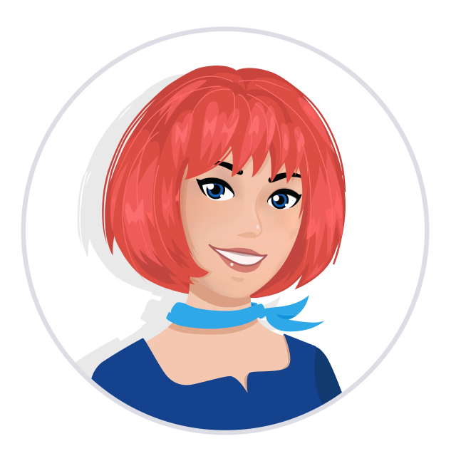
Postbank
One of the top banking institutions in Bulgaria
Employer of the year for 2017
Member of the Eurobank Group with € 58 billion of assets
Serious investments in digitization
The first bank credit botchat – EVA
https://www.facebook.com/evapostbank
https://www.postbank.bg/Za-nas/Careers

Slide 12

Draft Kings
Draft Kings
Award-winning sports betting solutions
iGaming platform
Looking for developers, mostly with JS and .NET
https://www.sbtech.com/careers

Slide 13

SmartIT
12+ years programming business-orientated solutions
ERP Systems
Mobile iOS & Android
Server Management
Sofia, Plovdiv, Varna and Ruse offices
Looking for .NET developers
https://www.smartit.bg

Slide 14




Software Group
Integration solutions for financial institutions
Provide digital transformation
Discovering Potential
Driving Innovation
Unlocking Opportunities

Slide 15

SuperHosting
The largest hosting company in Bulgaria
Hosting
Domains
WordPress Hosting
VPS Servers
SSL Certificates
E-Commerce
Offering a complete solution
Top-quality support
Top-qualified team
Leading technical equipment

Slide 16

Telenor
Key areas:
Digital channels
Analytics
UX design
Product development
Software/BI development
Open, adaptive, creative
Hub by Telenor: https://www.telenor.bg/careers/youth-vacancies
Notes:
Откриващ слайд
Ние сме Теленор… все още ☺. Официално на 01 август 2018 г. чешкият инвестиционен фонд PPF придоби дружествата Теленор в България, Сърбия, Черна гора и Унгария. В следващите две години ще запазим бранда Теленор.
Промени по стратегията ще има скоро. Със сигурност продължаваме трансформацията от телеком оператор към доставчик на дигитални услуги. И със сигурност няма да сме “mobile only”. Какво означава това ли? Предстои да разберем. Може да е IoT, Smart Homes, Smart Cities or other Automatisation, Analytics as a Service, Banking/Insurance, Video/audio on Demand, Live streaming… you name it.
Фокус все повече ще ни бъдат следните направления:
Digital channels
Analytics
UX design
Product development
Software/BI development
Разпозна ли се? За да сме в крак с времето ще запазим и културата си, в която предложенията идват отдолу и всяко мнение е ценно. Виж какво казва нашето последно изследване на ангажираността сред служителите.
Ако знаеш как да убедиш човек, който има телефон с копчета да ползва смартфон – заповядай при нас. Ако знаеш как да убедиш човек, който има смартфон да го ползва за всевъзможни дигитални услуги, които ще му улеснят живота и спестят време – заповядай при нас. Заповядай при нас, ако имаш идеи, които искаш да реализираш, ние ще ти помогнем. Но помни – реализацията на една идея е 10% креативност и 90% execution или по нашенски – бачкане.
Този месец стартираме и стажантската ни програма Hub by Telenor. Тя е едногодишна, платена и колегите-стажанти работят по реални проекти. Миналата година 9 от 10 от тях останаха при нас за постоянно (10-тата замина за Щатите да си търси късмета ☺). До края на седмицата ще обявим позициите на кариерния ни сайт http://www.telenor.bg/careers/youth-vacancies Не се колебай, влез, избери си и кандидатствай.
Не успяхме да ти кажем всичко. А ако ти предпочиташ личния контакт - на 28-29.09 ще бъдем на SoftUnit конференцията. Ела и ще се запознаеш с нашите колеги на щанда ни или ще чуеш лекторите ни на тема “Analytics Enablers for Business: Contextual Marketing Platform”. Ще говорят за нещо, което предстои да пуснем следващата седмица – една от най-актуалните теми за нас в момента.

Slide 17




XS Software
Gaming company, founded back in 2005 in Sofia
Over 50,000,000 registered players
Introduced the first browser games in Bulgaria
Looking for PHP Game Dev

Slide 18

OneBit Software
Software development and consulting company
Heavy involvement with the Microsoft SharePoint platform
Winning and delivering some of the best SharePoint projects
OneBit Survey Master
OneBit Quick Poll
https://www.onebitsoftware.net

Slide 19

Information Services
Key partner of the state institutions in the implementation of ICT projects
The Ministry of Finance
The National Revenue Agency
The Customs Agency
The Ministry of Regional Development and Public Works
The first governmentally approved provider of qualified certification services in Bulgaria
https://www.is-bg.net/bg

Slide 20

Tek Experts
Provider of deep software support and software solutions to the world’s largest-chip IT companies
.NET, HTML, CSS, JavaScript, Azure Cloud, Dynamics CRM/ERP, Network technologies and more
Looking for Software Support Engineers and Developers
Bulgaria, USA, Costa Rica, Nigeria, Vietnam, China, Rwanda
https://www.tek-experts.com/en-us/bulgaria

Slide 21

Zühlke
Swiss R&D Service company
We work for many different industries and a variety of compаnies from start-ups to global corporations
We use leading technologies to make innovations happen and deliver end-to-end solutions
Our teams are located in 8 countries across the globe
https://www.zuhlke.com

Slide 22

Coca-Cola HBC – Bulgaria
Coca‑Cola HBC is one of the world's largest bottlers of brands from the Coca‑Cola company
CCHBC started operations in Bulgaria in 1992 and since then is one of the biggest contributors to the local economy
Global company with over 30 thousand engaged people
https://bg.coca-colahellenic.com

Slide 23






SoftUni Diamond Partners

Slide 24



Educational Partners

Slide 25

The Trainers
The Trainers for the Software Engineering Program

Slide 26
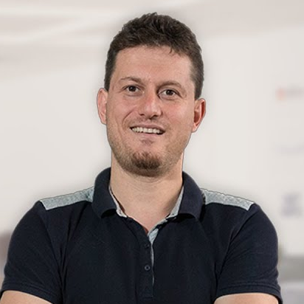
Svetlin Nakov, PhD
Co-Founder of SoftUni
Training & Inspiration Manager @ Software University (SoftUni)
20+ years as software developer
10+ years experience as trainer
Author of 8 programming books
Speaker at hundreds of events
Web site & blog: nakov.com

Slide 27
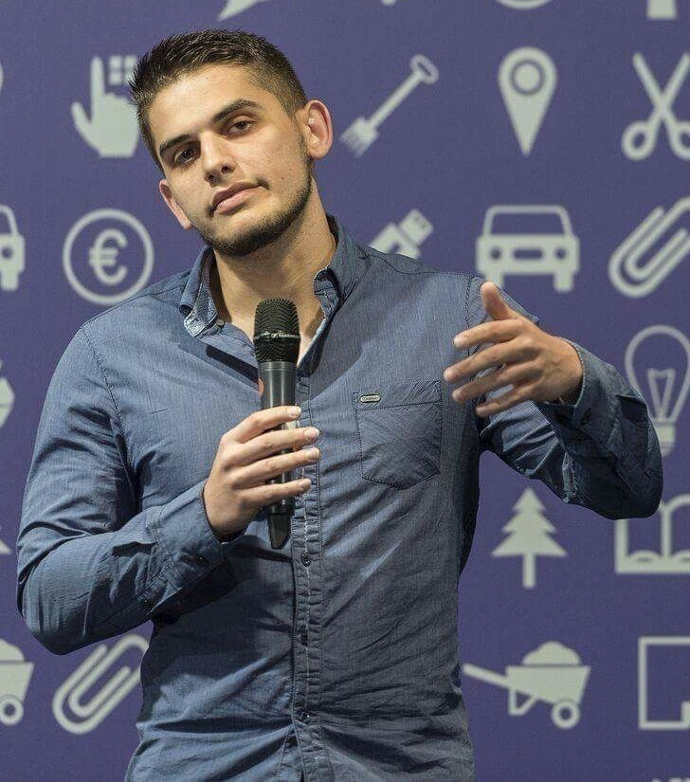
Viktor Dakov
Senior Developer SDE 3, Nuvolo
Worked at Amazon
John Atanasoff award
Participated in many programming contests
6+ years of experience as a developer

Slide 28
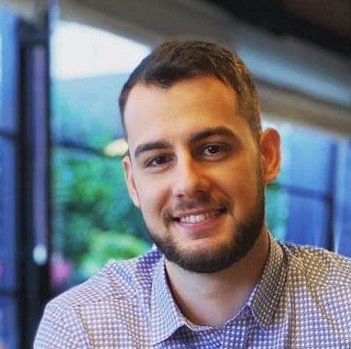
Dimo Georgiev
Software Developer @ SAP
Oracle Certified Java Professional
Computer and Software Engineering at Technical university of Sofia

Slide 29
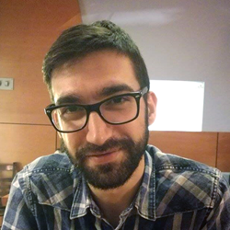
Viktor Kostadinov
Nearly 5 years experience as a technical trainer in the IT field
Head of the R&D Unit at Software University
Former Director of the Education Department
JavaScript enthusiast

Slide 30
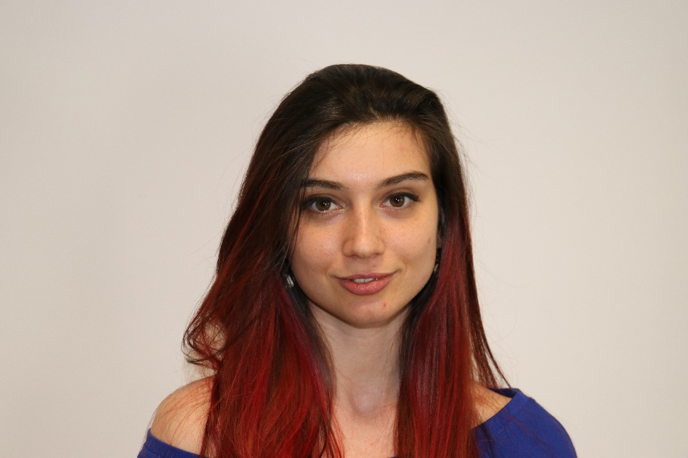
Ines Ivanova
Python web developer at IQVIA
Full stack freelance developer
Python, Django, C#, Angular, HTML, CSS, jQuery, Flask

Slide 31
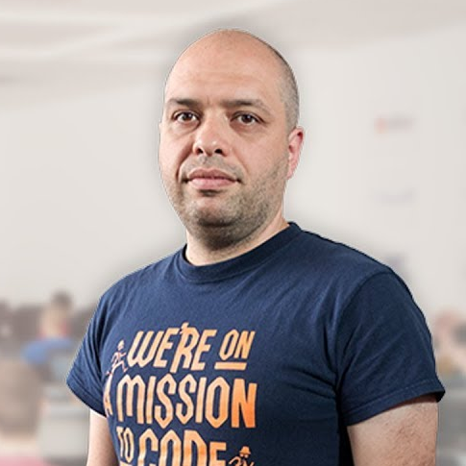
Stamo Petkov
Head Of Department at Information Services Plc.
Worked with various technologies
.NET and C#, BASIC, Pascal, Object Pascal, PHP
More than 15 years of experience
Experienced Technical Trainer

Slide 32
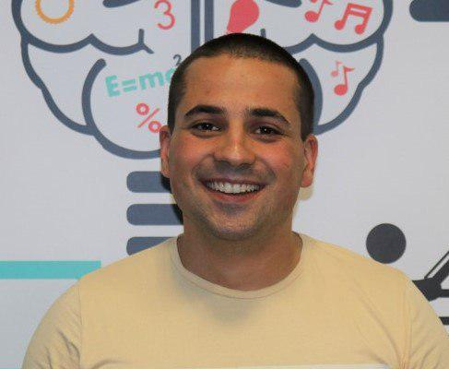
Martin Paunov
Java Developer at Virtual Racing School
Experience with Java, C++, C#
Technical Trainer @ SoftUni
Interested in Astrophysics

Slide 33
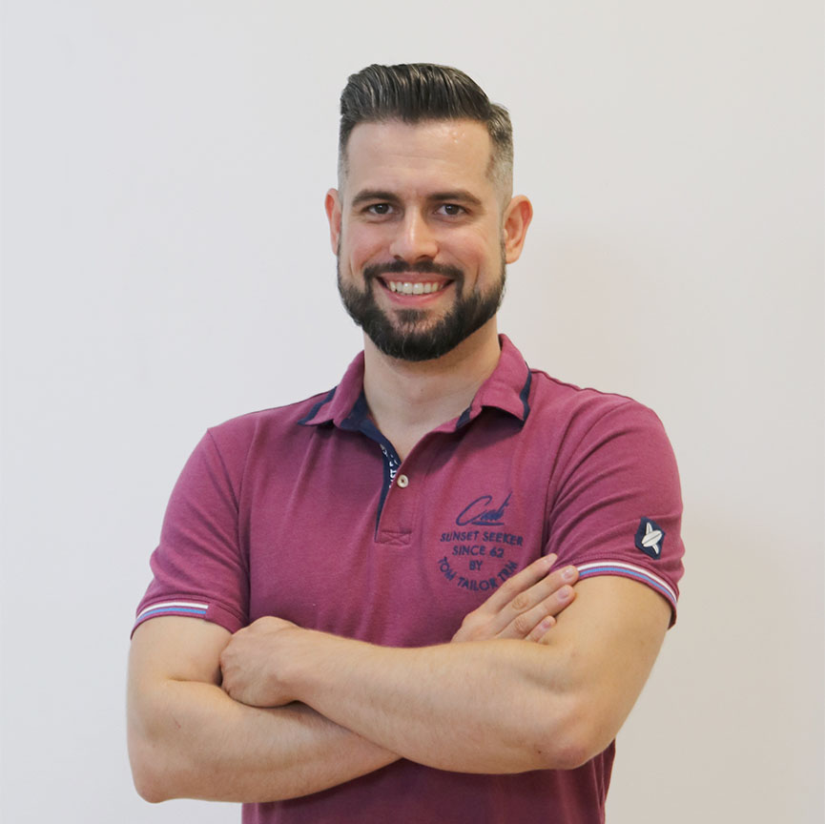
Ivaylo Papazov
Senior Full-Stack Developer and Team Lead @ Motion Software
Technical Trainer @ SoftUni
Experience in JS, C#, Node.js, React, ASP.NET MVC
TelerikAcademy Graduate

Slide 34
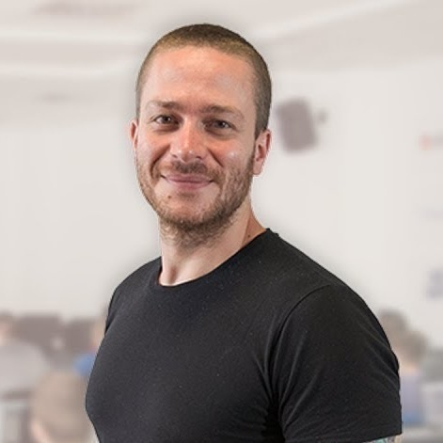
Ivaylo Kenov
Various job titles at the same time:
CTO @ SoftUni Dev Team
Technical Trainer @ SoftUni
Creator of open-source libraries for ASP.NET
MyTested.AspNetCore.Mvc
Mathematical competitions champion
Contacts:
https://github.com/ivaylokenov
https://linkedin.com/in/kenov

Slide 35
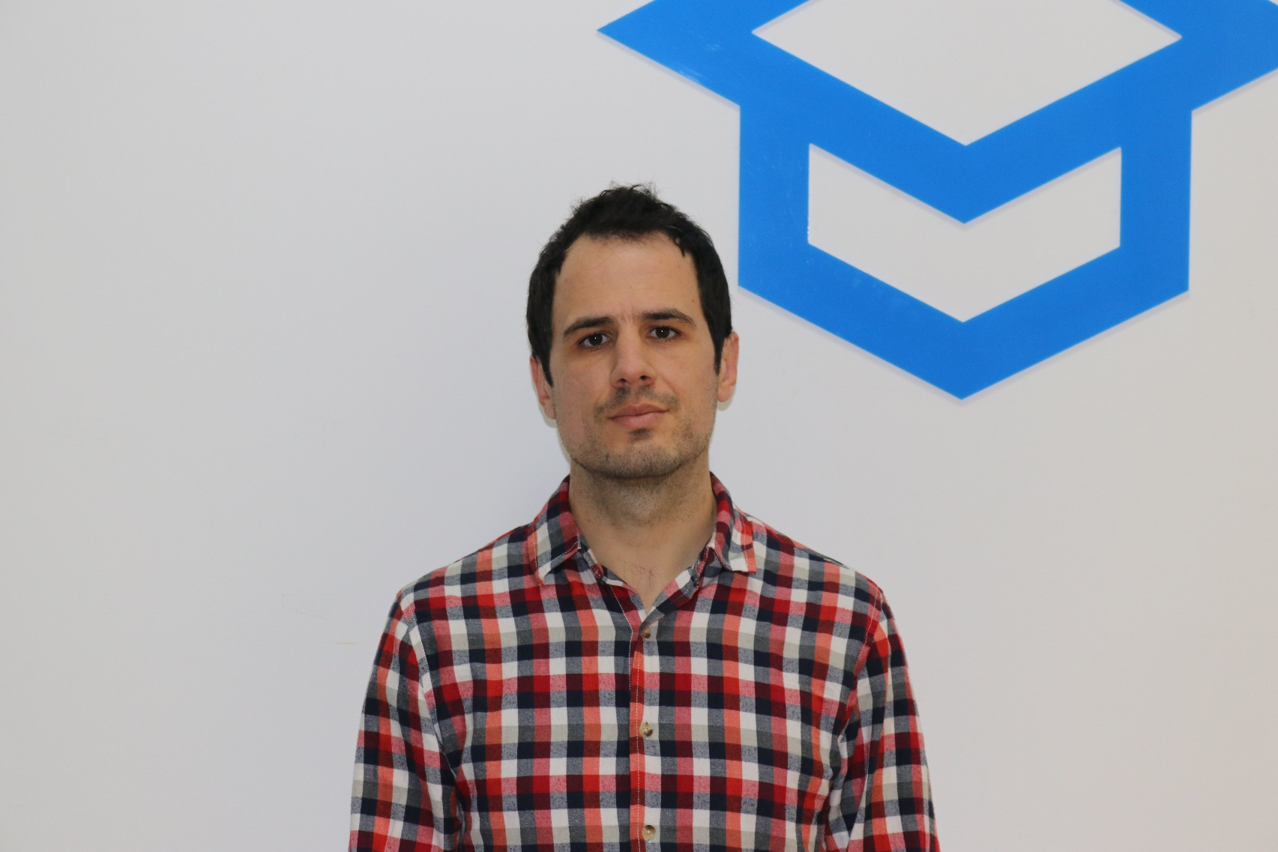
Veselin Vachev
Team Lead @ Netinfo
9 years full-stack web developer
Back-end / front-end, SEO, UX
Making CD / CI Systems
Current projects: Gong.bg, Nova.bg, Dariknews.bg, Vesti.bg, Sinoptik.bg

Slide 36
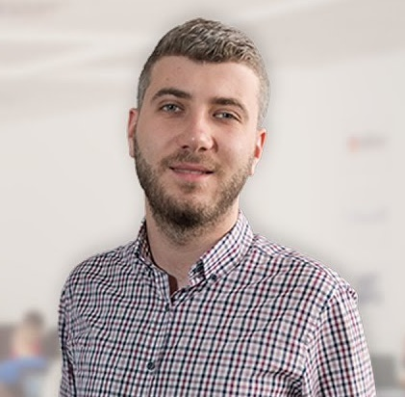
Ivan Yonkov
CEO @ Codexio
Former CTO @ LockTrip
Former Training Director @ SoftUni
5+ years developer experience
3+ years QA experience
4+ years of being Technical Trainer @ SoftUni

Slide 37
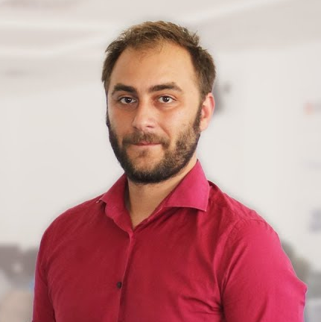
Doncho Minkov
Senior Full Stack Developer in SoftUni
10+ years in IT
8+ years of experience as a Technical Trainer in Telerik Academy
Front-end developer by heart
Software developer by need
Experience with all popular mobile platforms
Android, iOS, Windows
Fluent in Node.js, .NET, Angular, Java, C++
"30 under 30" - Forbes 2017 - Education

Slide 38
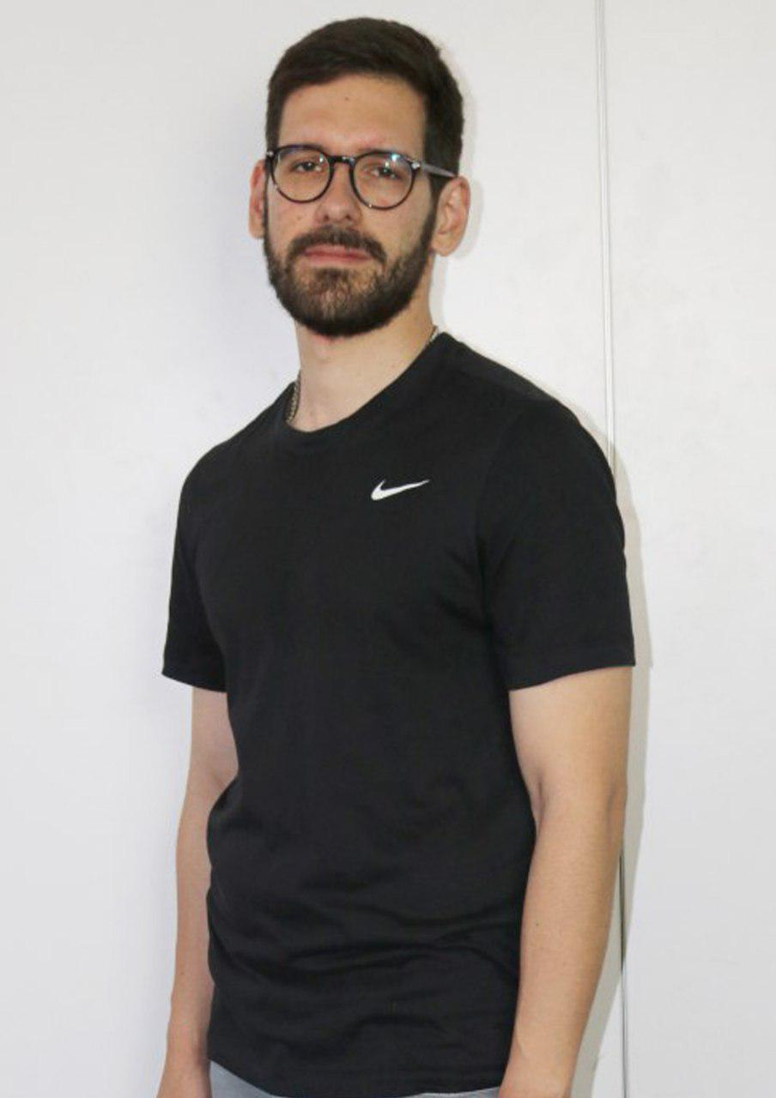
Ilia Idakiev
Software developer-entrepreneur
Co-Founder @ HILLGRAND
Google Developer Expert
Co-organizer of Angular Sofia and SofiaJS / BeerJS
Lecturer at Sofia University (FMI)
"Advanced JavaScript" course

Slide 39

Nikolay Kostov
Solutions Architect @ ZenCodeo
15+ years in IT
Takes an active role in the development of the https://judge.softuni.bg
Microsoft Certified Trainer
https://nikolay.it

Slide 40
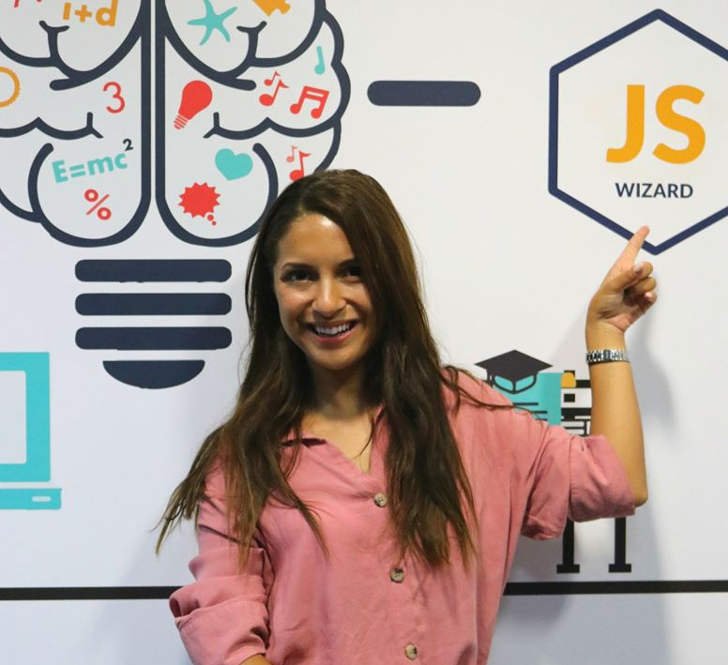
Antonia Atanasova
Passionate about Front-End Development
Technical Trainer in SoftUni
Web Development Freelancer
Contacts:
http://antoniaat.com

Slide 41
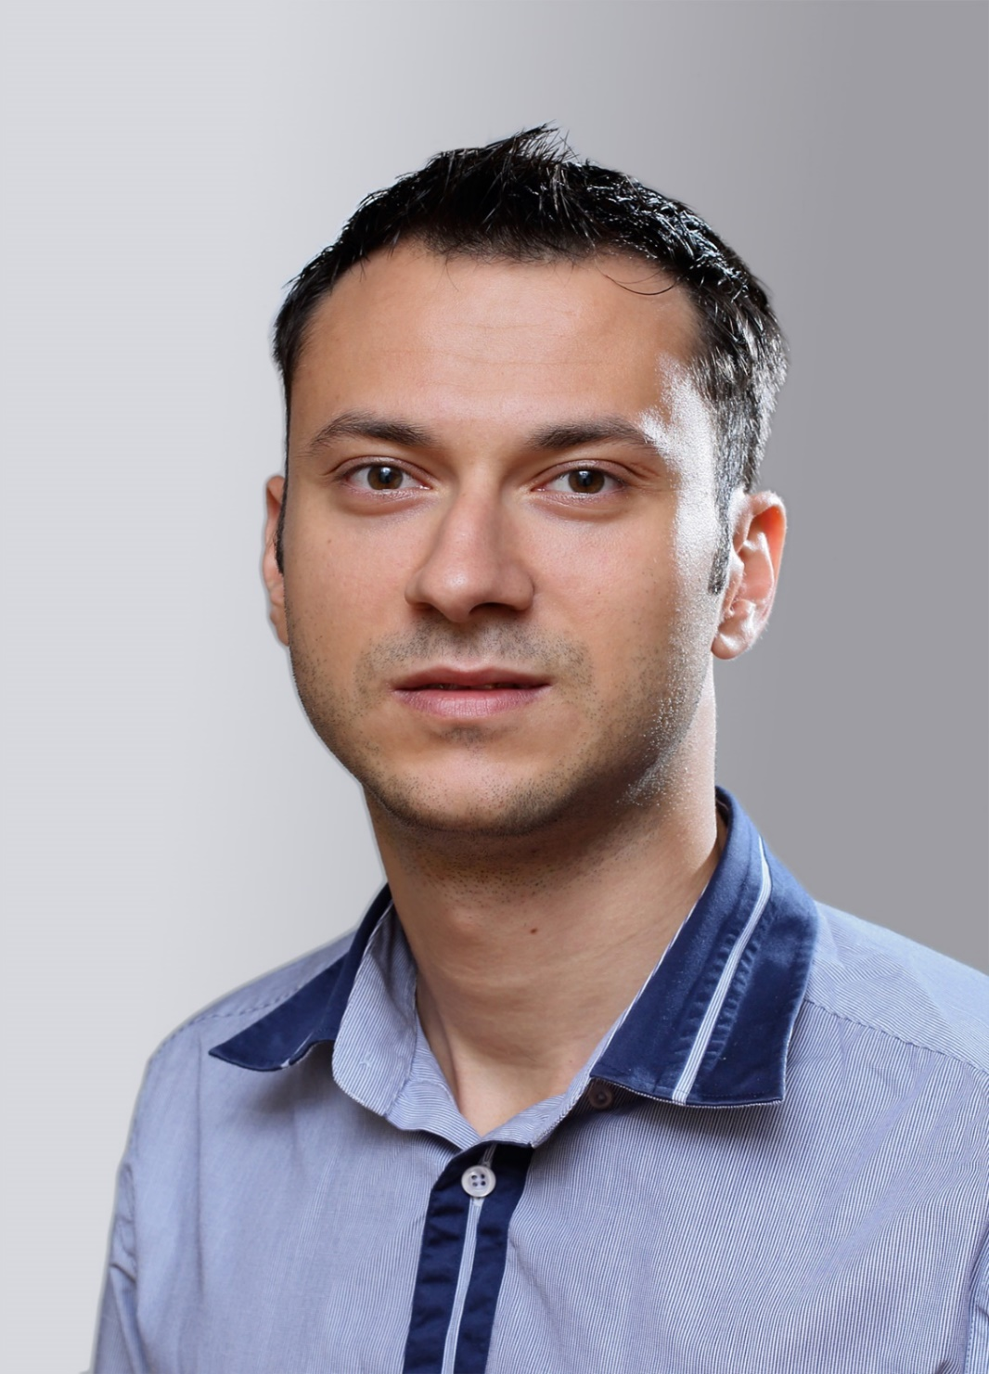
Dimo Mitev
QA Architect @Progress
More than 15 years of working experience and 9 years of training experience
ISTQB certified trainer
Certified Scrum Master
Conference speaker, author of QA articles and reviewer of QA books

Slide 42
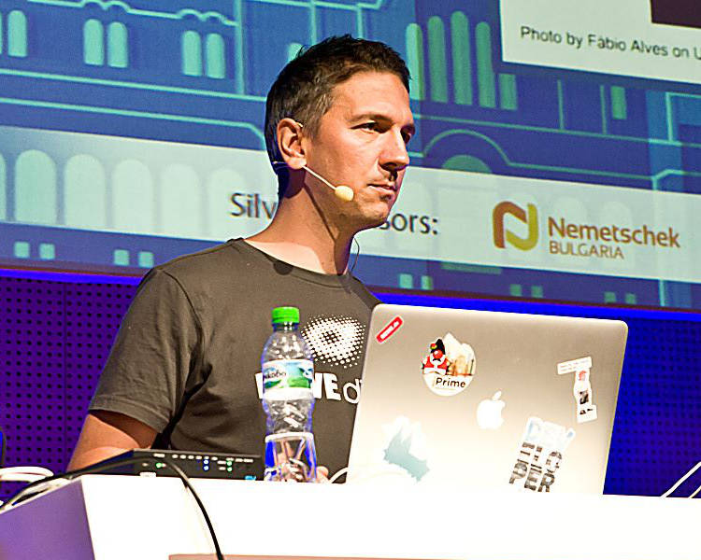
Lachezar Balev
Software engineer with 19+ years of real experience with different projects
Started developing with Java in the
year 2000 in the form of J2SE 1.2
Works in REWE Digital Bulgaria on an architecture focused on microservices
Uses Java, TypeScript and Kotlin
in his daily tasks
Personal website: http://balev.eu/.

Slide 43

Learning Paths and Opportunities
The Choice is Yours

Slide 44
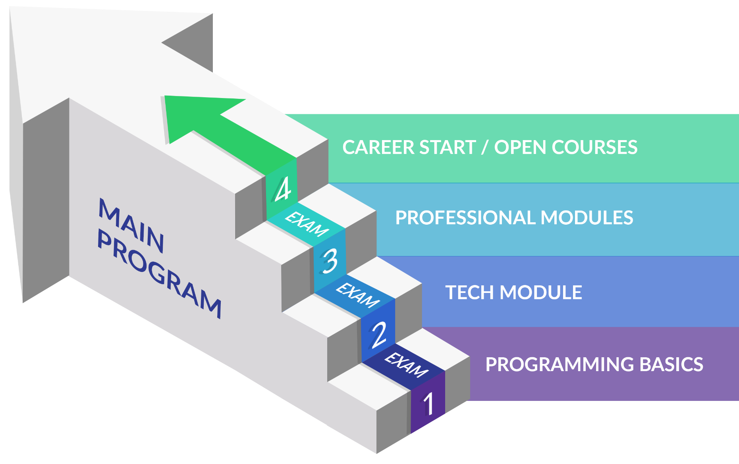
Software Engineering: Educational Program
Learning tracks: C#, Java, JavaScript, Python, QA

Slide 45
Curriculum
Entry Module
Programming Basics
2 months
Fundamental Module
Fundamentals Module
4 months
Professional Modules
Java
C#
Python
JS
QA
12-16 months
https://softuni.bg/trainings/courses

Slide 46

Trainee Program

Slide 47
Questions?
Notes:
47

Slide 48
Trainings @ Software University (SoftUni)
Software University – High-Quality Education, Profession and Job for Software Developers
softuni.bg, about.softuni.bg
Software University Foundation
softuni.foundation
Software University @ Facebook
facebook.com/SoftwareUniversity
Software University Forums
forum.softuni.bg
Notes:
48

Slide 49

License
This course (slides, examples, demos, exercises, homework, documents, videos and other assets) is copyrighted content
Unauthorized copy, reproduction or use is illegal
© SoftUni – https://about.softuni.bg/
© Software University – https://softuni.bg
Notes:
49

